Slide 1
Visualizing Operational Efficiency in Animal Shelters
By – Manasa Pullabhatla

Slide 2
Milestones / Development Process
Reliable data was gathered and verified for suitability in addressing the defined objectives and questions.
The data was cleaned, manipulated, and structured to create clear and informative visuals.
Visualizations were generated to answer the questions, summarize findings, and provide insights on future opportunities, along with practical suggestions for shelter improvement.

Slide 3
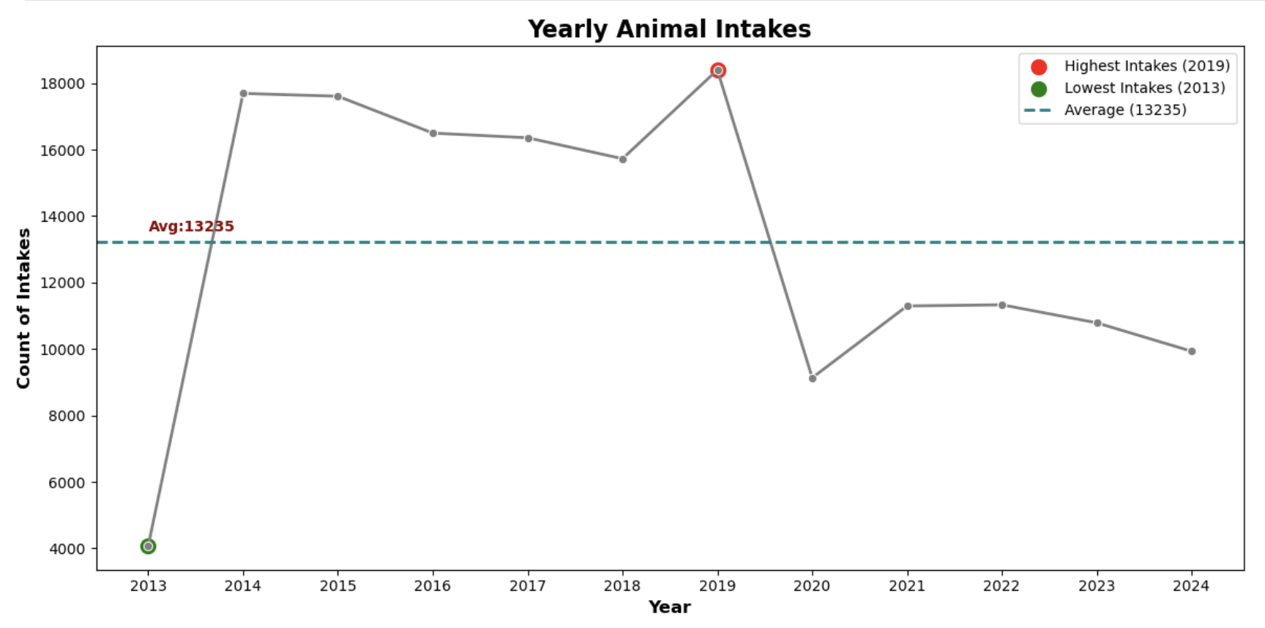
1. How many animals are brought into the shelter on average yearly?
2019 had the highest intakes, while 2013 had the lowest. On average, the shelter receives 13,235 intakes per year, with a noticeable drop in 2020 due to the COVID-19 pandemic.

Slide 4
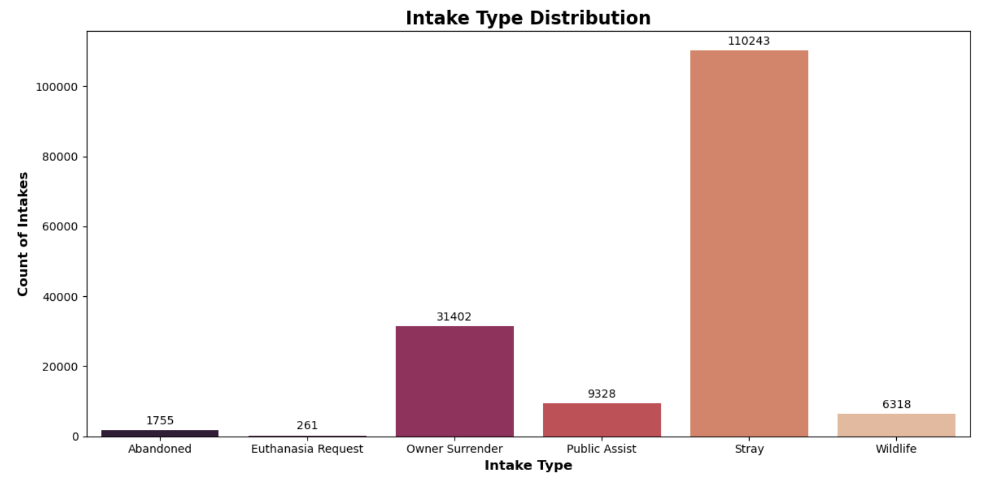
2. Which intake type is contributing to the influx of animals into the shelter?
Stray rescues were the most common intake type, followed by Owner Surrender and Public Assist, with a relatively low number of euthanasia requests.

Slide 5
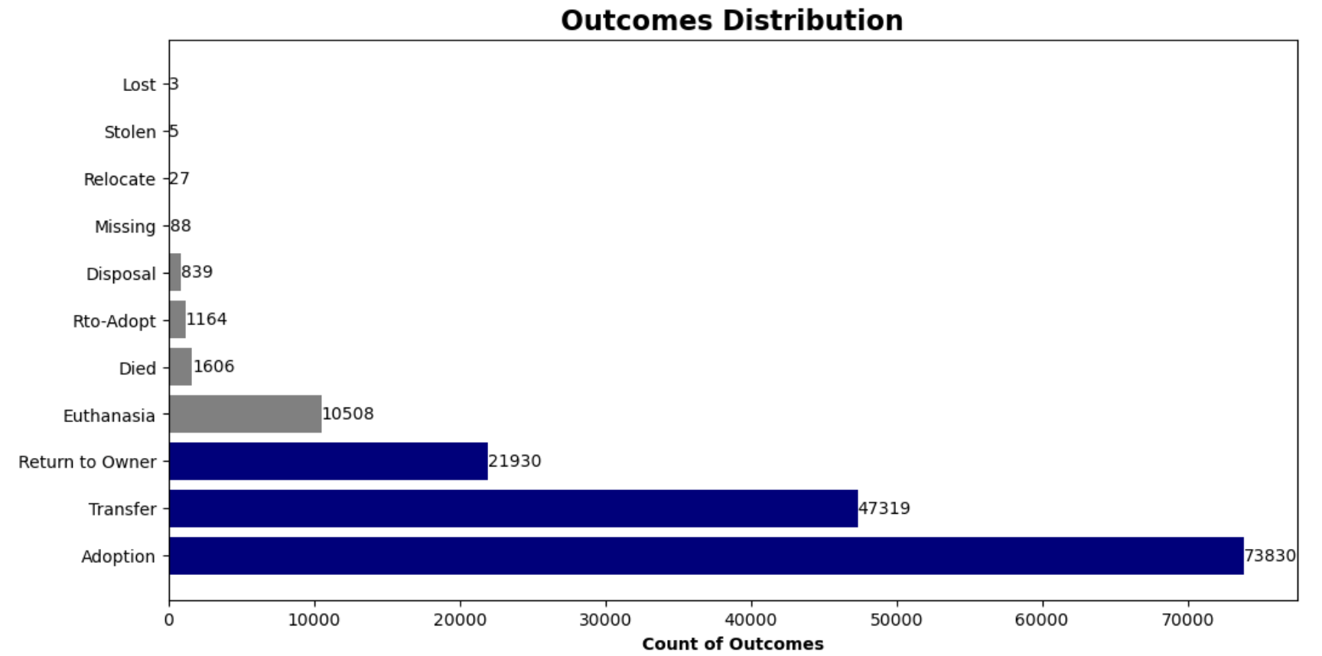
3. What can be the possible outcomes for the animals that are taken into the shelter?
Adoptions are the most common outcome, followed by Transfers and Return to Owner, indicating successful rehoming and relocation efforts.

Slide 6
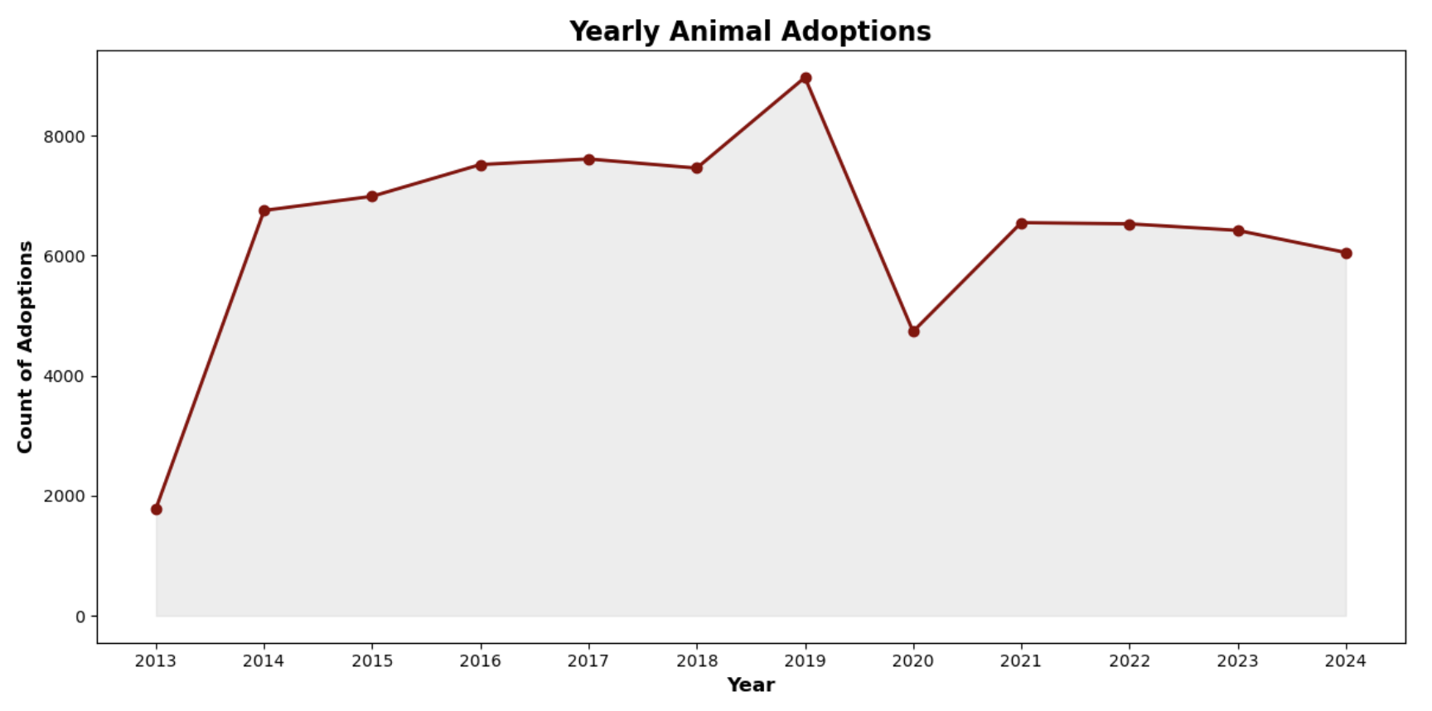
4. Over time, has the adoption rate of animals from the shelter increased or decreased?
After an initial increase, adoptions saw a sharp decline in 2020 and have continued to decrease gradually post-COVID, signaling potential challenges in rehoming animals.

Slide 7
SUGGESTIONS
Adoption Campaigns: Run targeted campaigns on social media, hold adoption events, and collaborate with local businesses to boost adoptions.
Community Outreach: Build stronger community connections to encourage fostering and volunteering, helping with animal care and placements.
Data-Driven Decisions: Keep analyzing trends to improve strategies and resource use, ensuring better support for animals.

Slide 8
CONCLUSION
In summary, the shelter has witnessed significant trends in intake types, outcomes, and adoption rates over the years. While the shelter has seen a steady number of intakes, particularly from strays, there has been a noticeable decline in adoptions, especially post-COVID. This highlights a potential area of concern for the shelter's operations and long-term capacity to assist animals in need.

Slide 9
THANK YOU

